Slide 1
Ch. 4 Retiming (Tái định thì)
ĐHBK Tp HCM
BMĐT
GV: Hồ Trung Mỹ
TLTK:
Các slide từ sách của Prof. Parhi
Slide của Prof. Viktor Öwall
Slide của Prof. Lan-Da Van

Slide 2
Outline
4.1 Introduction
4.2 Definitions and Properties
Quantitative Description of Retiming
Properties of Retiming
4.3 Solving Systems of Inequalities
4.4 Retiming Techniques
Cutset Retiming and Pipelining
Retiming for Clock Period Minimization
Retiming for Register Minimization
4.5 Conclusions

Slide 3
4.1 INTRODUCTION
Retiming is a transformation technique used to change the locations of delay elements in a circuit without affecting the input/output characteristics of the circuit.
For example, consider the IIR filters in Fig. 4.1(a) & (b). Although the filters in Fig. 4.1(a) and Fig. 4.1(b) have delays at different locations, these filters have the same input/output characteristics. These 2 filters can be derived from one another using retiming.

Slide 4
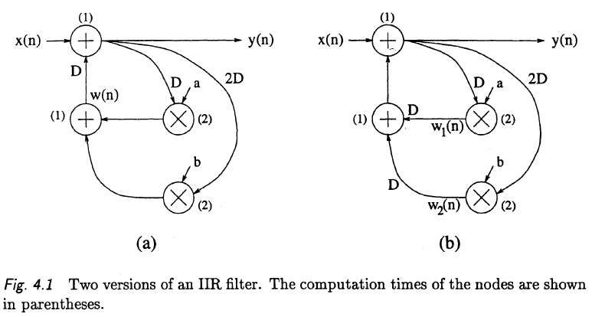
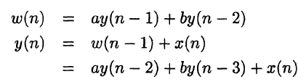
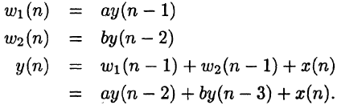
Example:
The filter in Fig. 4.1(a) is described by
The filter in Fig. 4.1(b) is described by

Slide 5
Applications of Retiming
Retiming has many applications in synchronous circuit design. These applications include
reducing the clock period of the circuit,
reducing the number of registers in the circuit,
reducing the power consumption of the circuit, and
logic synthesis

Slide 6
Applications of Retiming (cont’d)
Retiming can be used to increase the clock rate of a circuit by reducing the computation time of the critical path. For example:
The critical path of the filter in Fig. 4.1(a) = T_{M} +T_{A} = 3 u.t. => this filter cannot be clocked with a clock period of less than 3 u.t.
The retimed filter in Fig. 4.1(b) = T_{A}+T_{A} = 2 u.t. => this filter can be clocked with a clock period of 2 u.t.
By retiming the filter in Fig. 4.1(a) to obtain the filter in Fig. 4.1(b), the clock period has been reduced from 3 u.t. to 2 u.t., or by 33%.
Retiming can be used to decrease the number of registers in a circuit. The filter in Fig. 4.1 (a) uses 4 registers while the filter in Fig. 4.1 (b) uses 5 registers.
Since retiming can affect the clock period and the number of registers, it is sometimes desirable to take both of these parameters into account.

Slide 7
Applications of Retiming (cont’d)
Retiming can be used to reduce the power consumption of a circuit by reducing switching, which can lead to dynamic power dissipation in static CMOS circuits [2].
Placing registers at the inputs of nodes with large capacitances can reduce the switching activities at these nodes, which can lead to low-power solutions (see Section 17.5.4).

Slide 8
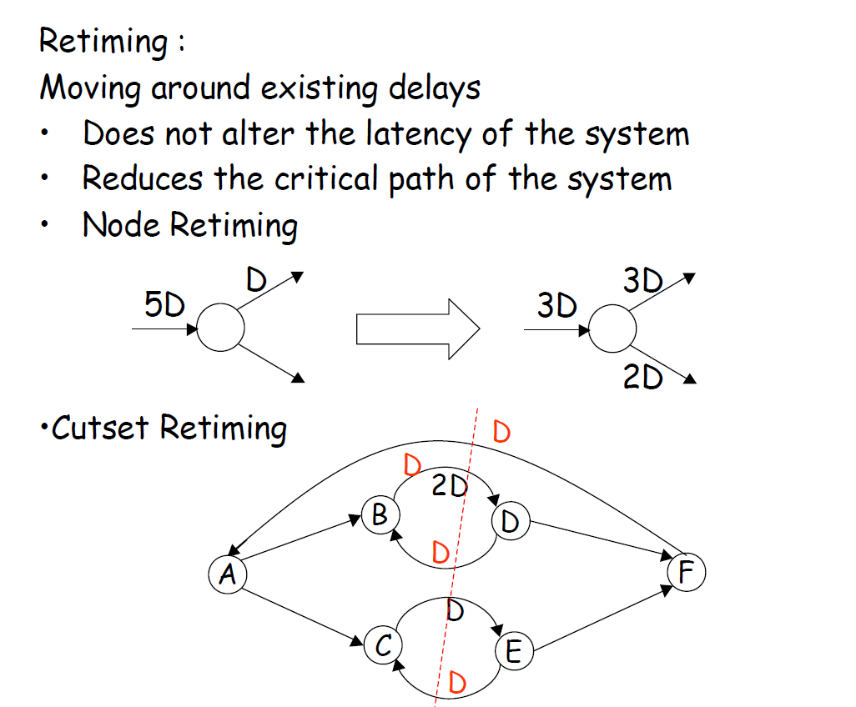

Slide 9
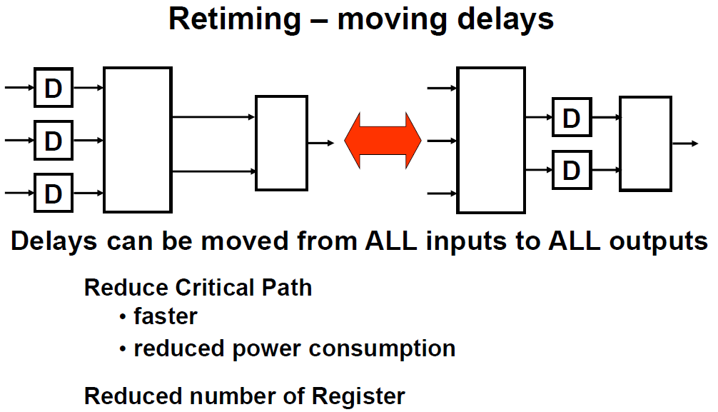

Slide 10
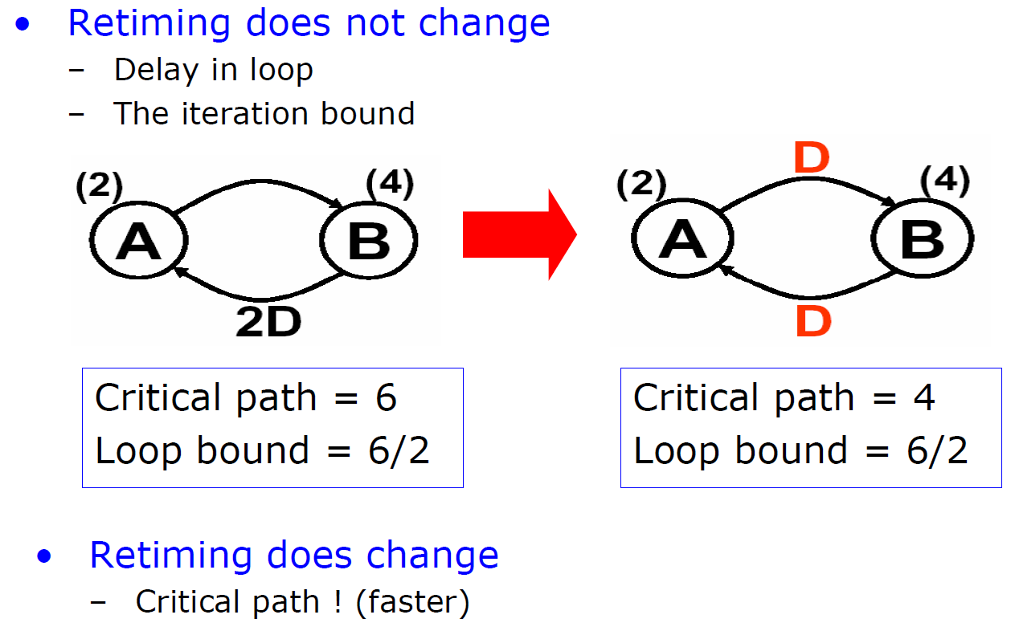
Example:

Slide 11
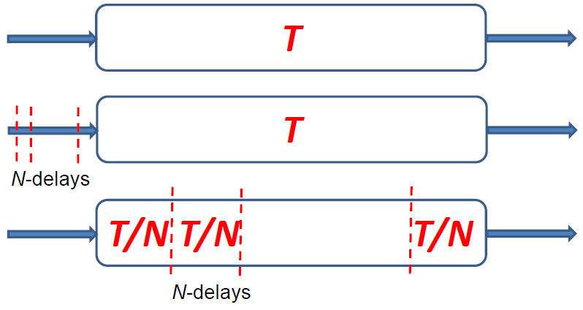
Retiming – Pipelining
Generalization of Pipelining
Pipelining is equivalent to introducing delays at the input followed by retiming

Slide 12
4.2 DEFINITIONS AND PROPERTIES 4.2.1 Quantitative Description of Retiming
Retiming maps circuit G to a retimed circuit G_{r}
Retiming solution characterized by a value r(V) for each node V in graph
Let w(e) denote weight of edge e of graph G, and w_{r}(e) denote weight of edge e of graph G_{r}
Weight of edge from U V in the retimed graph is computed from weight of edge in original graph using w_{r}(e) = w(e) + r(V) - r(U)
Retiming solution is feasible if w_{r}(e) >= 0 for all edges
e

Slide 13
Node Retiming
Retiming equation:
subject to w_{r}(e) ≥ 0.
Let p be a path from v₀ to v_{k}
then
Transfer delay through a node in DFG:
r(v) = # of delays transferred from out-going edges to incoming edges of node v
w(e) = # of delays on edge e
w_{r}(e) = # of delays on edge e after retiming
u
e
v
3D
D
2D
r(v) = 2
v
v
2D
D
3D
v₀
e₀
v₁
e₁
…
e_{k}
v_{k}
p

Slide 14
Invariant Properties
Retiming does NOT change the total number of delays for each cycle.
Retiming does not change loop bound or iteration bound of the DFG
If the retiming values of every node v in a DFG G are added to a constant integer j, the retimed graph G_{r} will not be affected. That is, the weights (# of delays) of the retimed graph will remain the same.

Slide 15
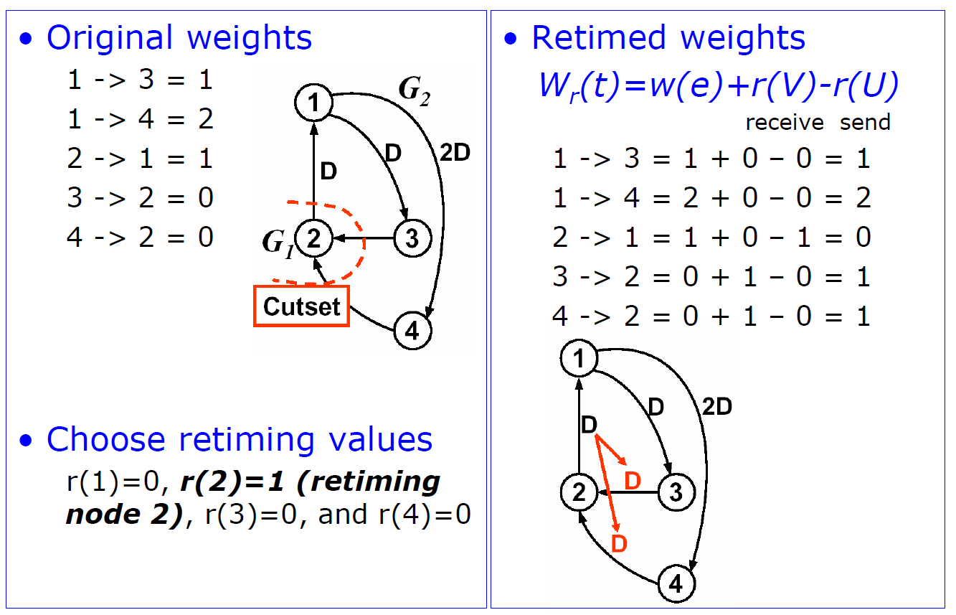
Example:

Slide 16
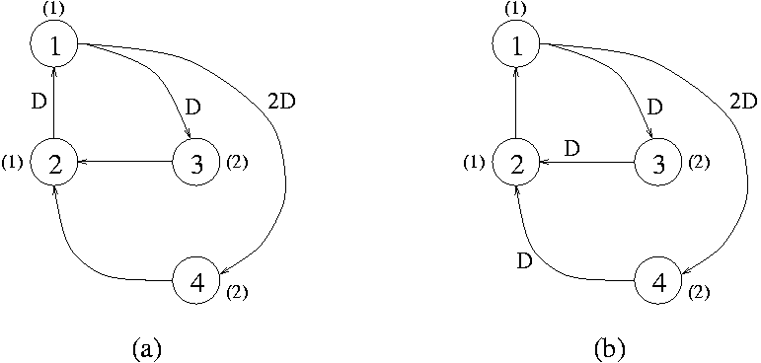
DFG Illustration of the Example
T∞ = max. {(1+2+1)/2, (1+2+1)/3} = 2
Cr. Path delay = 2+1 = 3 t.u
T∞ = max. {(1+2+1)/2, (1+2+1)/3} = 2
Cr. Path Delay = max{2,2,1+1} = 2 t.u

Slide 17
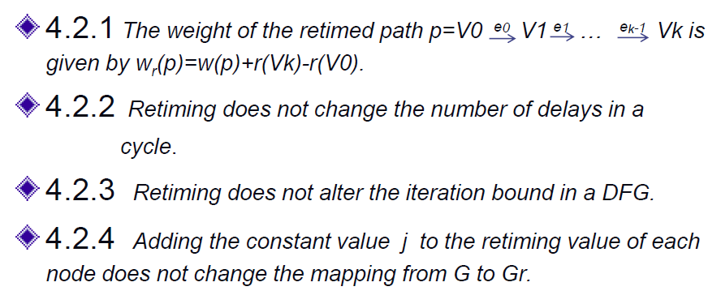
4.2.2 Properties of Retiming
Weight of a path from node 0 to node k is number of delays between those nodes
Computation time of a path between node 0 to node k is the sum of computation times (adders, etc.) of each of the nodes

Slide 18
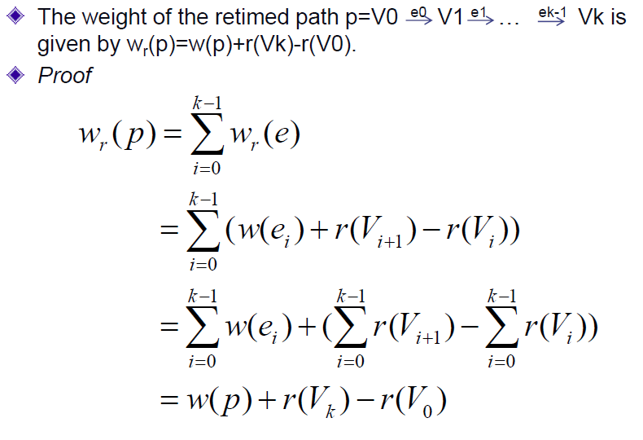
Property 4.2.1

Slide 19
4.3 Solving Systems of Inequalities
Given a set of M inequalities and N variables, where each inequality has the form r_{i} – r_{j} <= k for integer values of k, can use one of shortest path algorithms to determine if solution exists and to find one solution
Shortest path algorithms (Appendix A of Parhi book)
Bellman-Ford
Floyd-Warshall

Slide 20
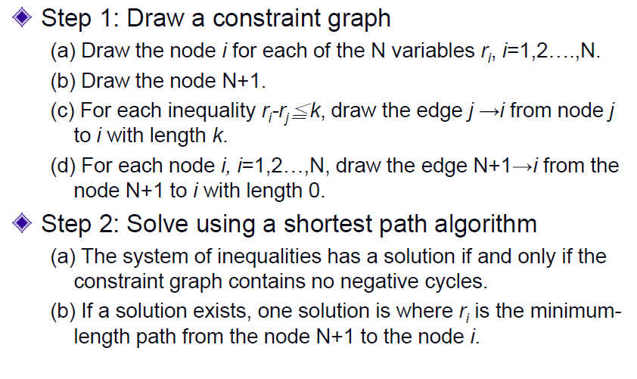
Solving Systems of Inequalities

Slide 21
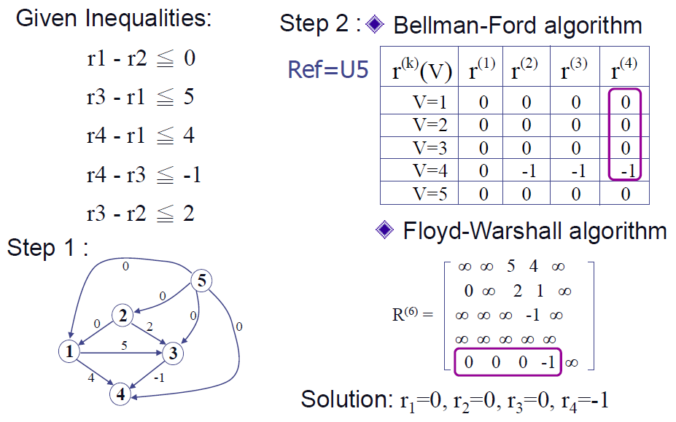
Example 4.3.1 with M=5, N=4 (1/2)

Slide 22
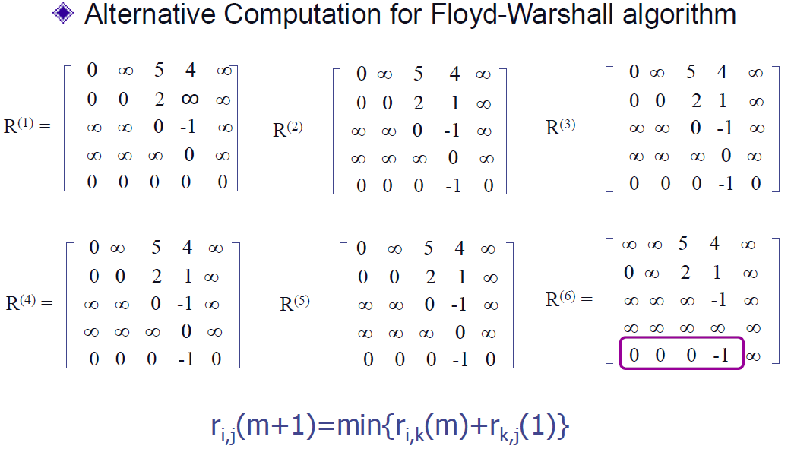
Example 4.3.1 with M=5, N=4 (2/2)

Slide 23
4.4 RETIMING TECHNIQUES
This section considers some techniques used for retiming:
First, two special cases of retiming, namely, cutset retiming and pipelining, are considered.
Two algorithms are then considered for etiming to minimize the clock period and retiming to minimize the number of registers that are required to implement the circuit.

Slide 24
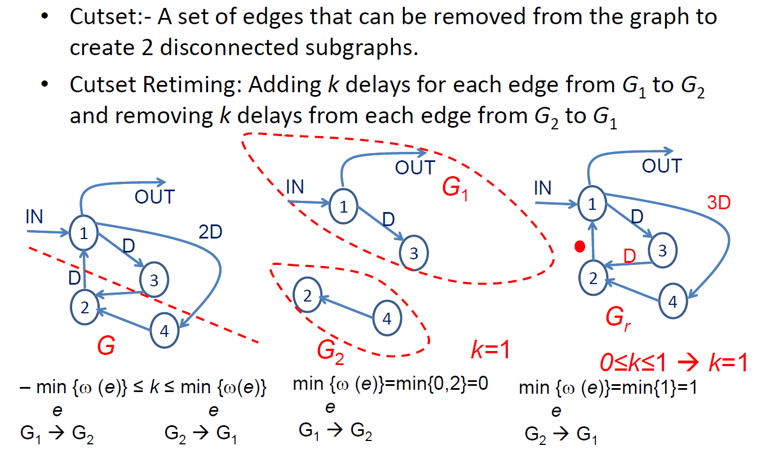
4.4.1 Cutset Retiming and Pipelining
Cutset Retiming

Slide 25
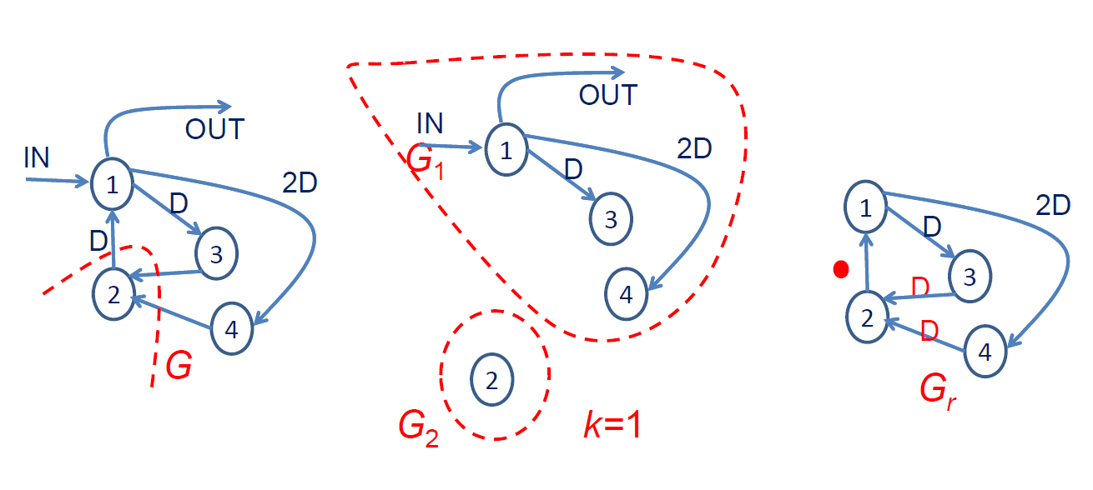
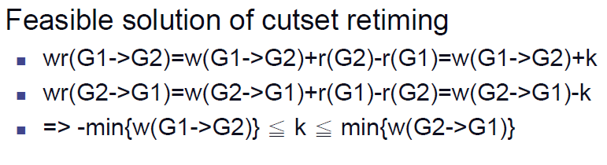
Single Node Subgraph Cutset Retiming

Slide 26
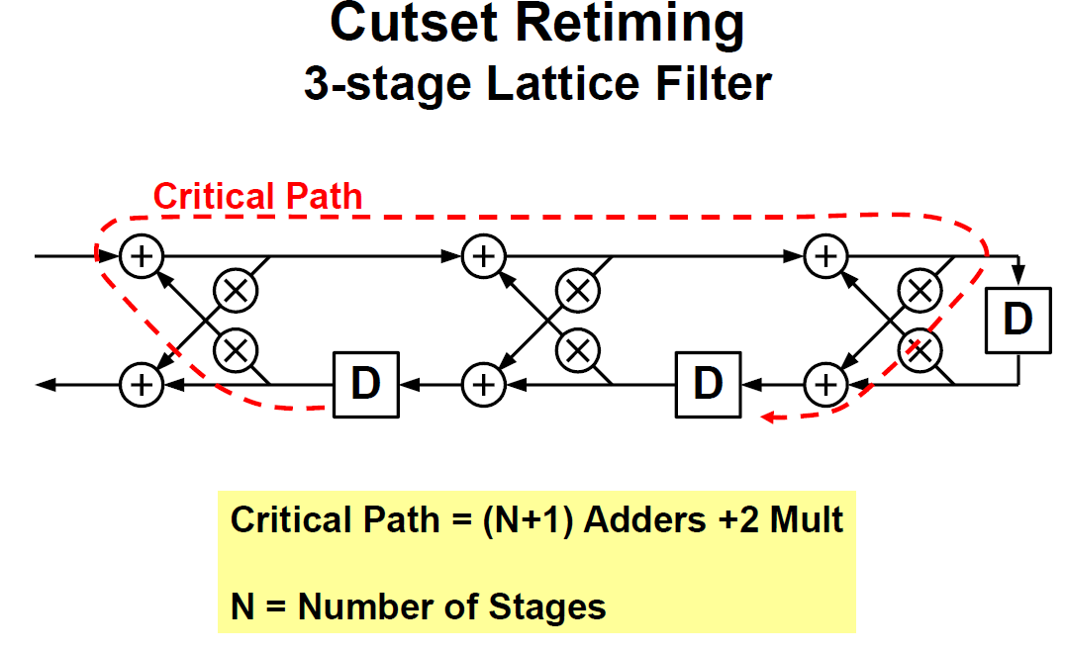

Slide 27
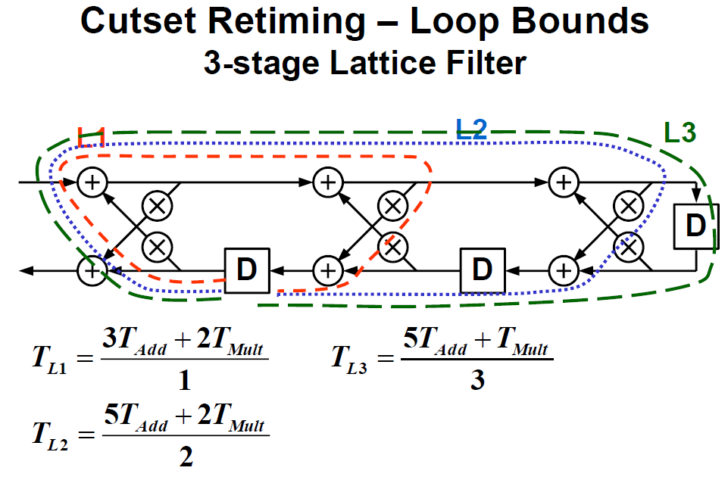
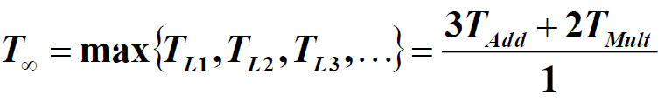
Iteration Bound:

Slide 28
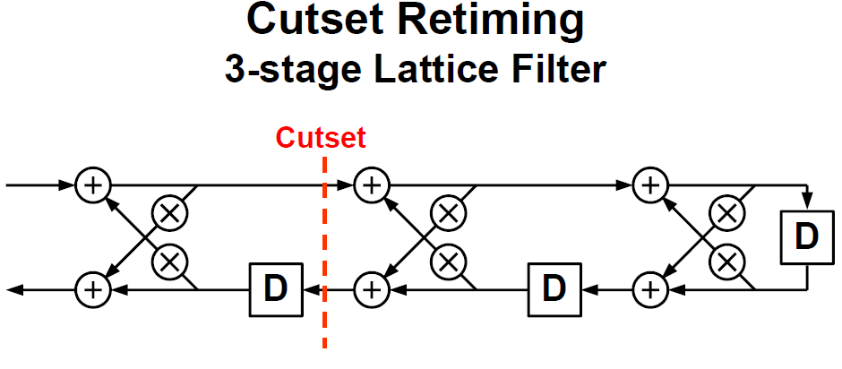

Slide 29
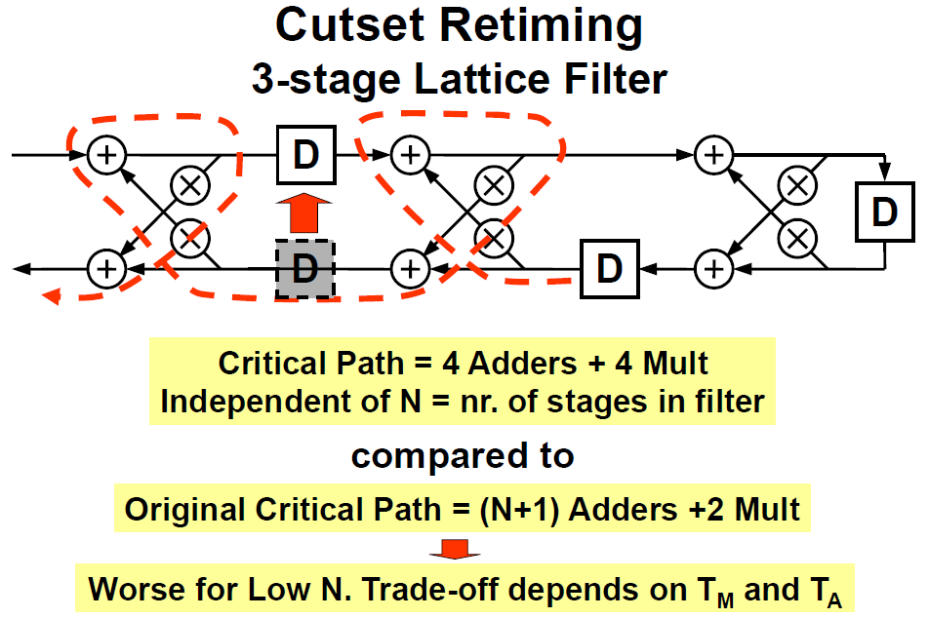

Slide 30
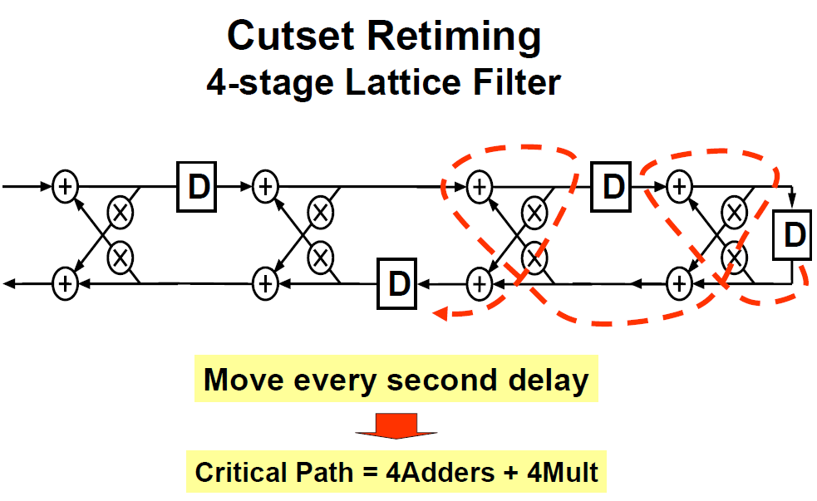

Slide 31
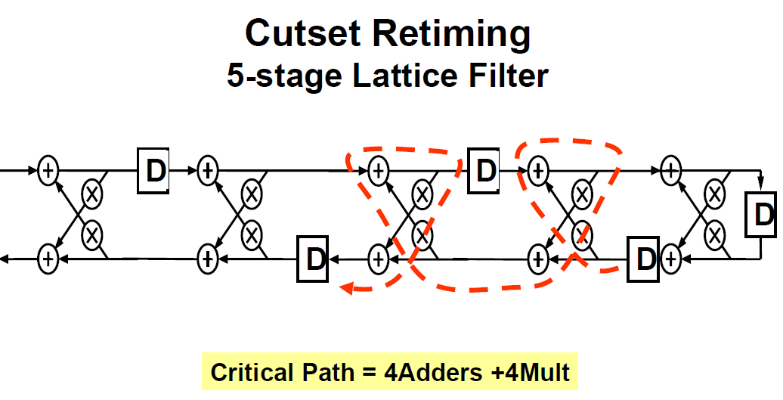
Independent on N!
How do we minimize clock period?
Add k-slow transformation before retiming.

Slide 32
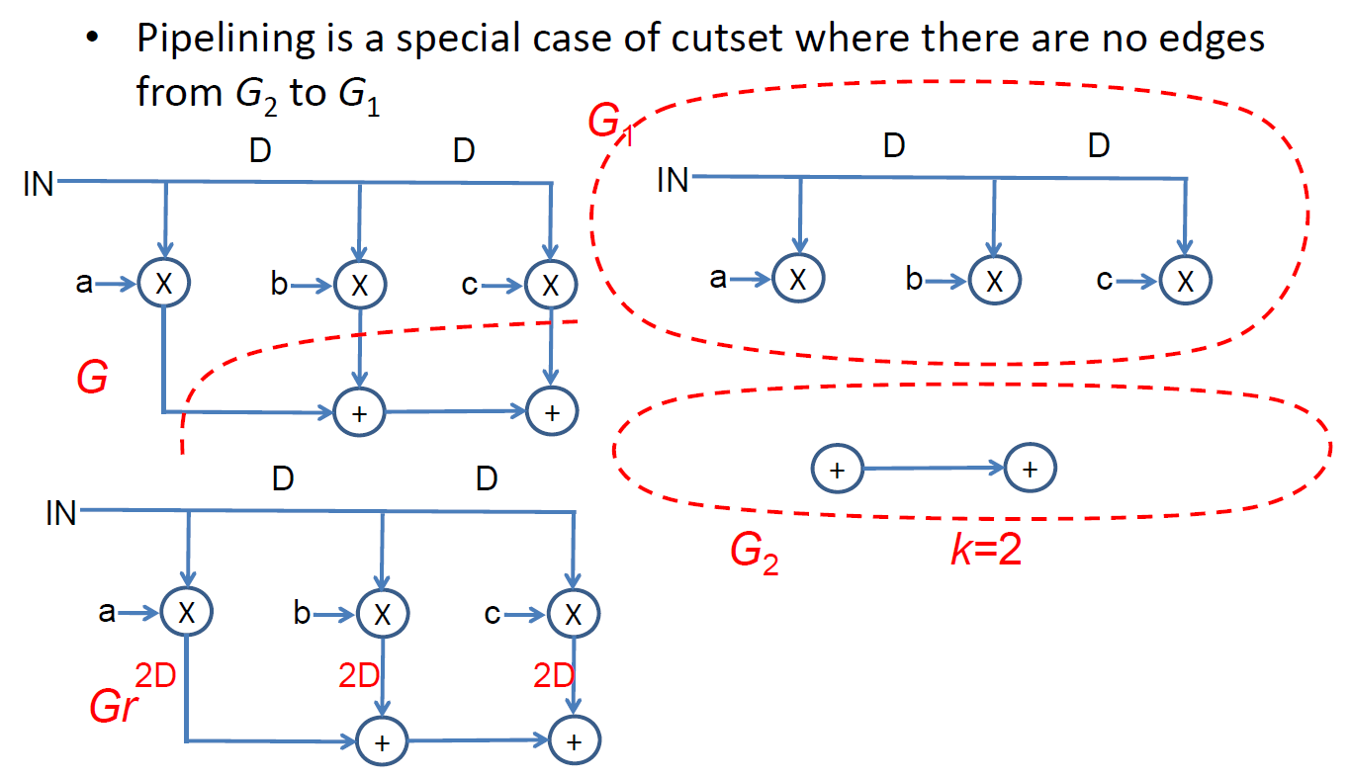
Pipelining
(a)
(b)
(c)
Fig. 4.6 (a) The unretimed DFG with a cutset shown as a dashed line. (b) The 2
graphs G1 and G2 formed by removing the edges in the cutset. (c) The graph obtained
by cutset retiming with k = 2.

Slide 33
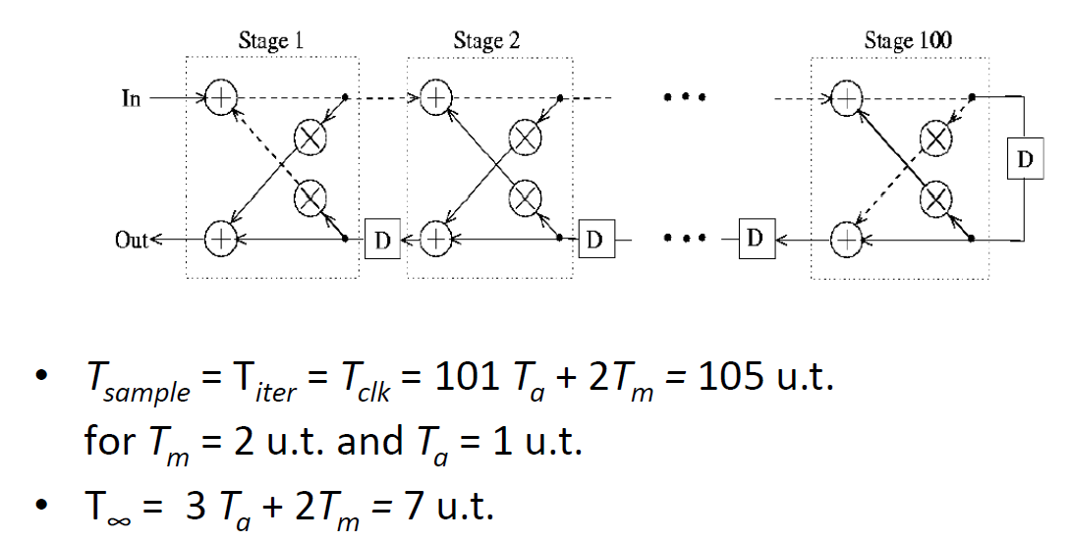
Lattice Filter

Slide 34
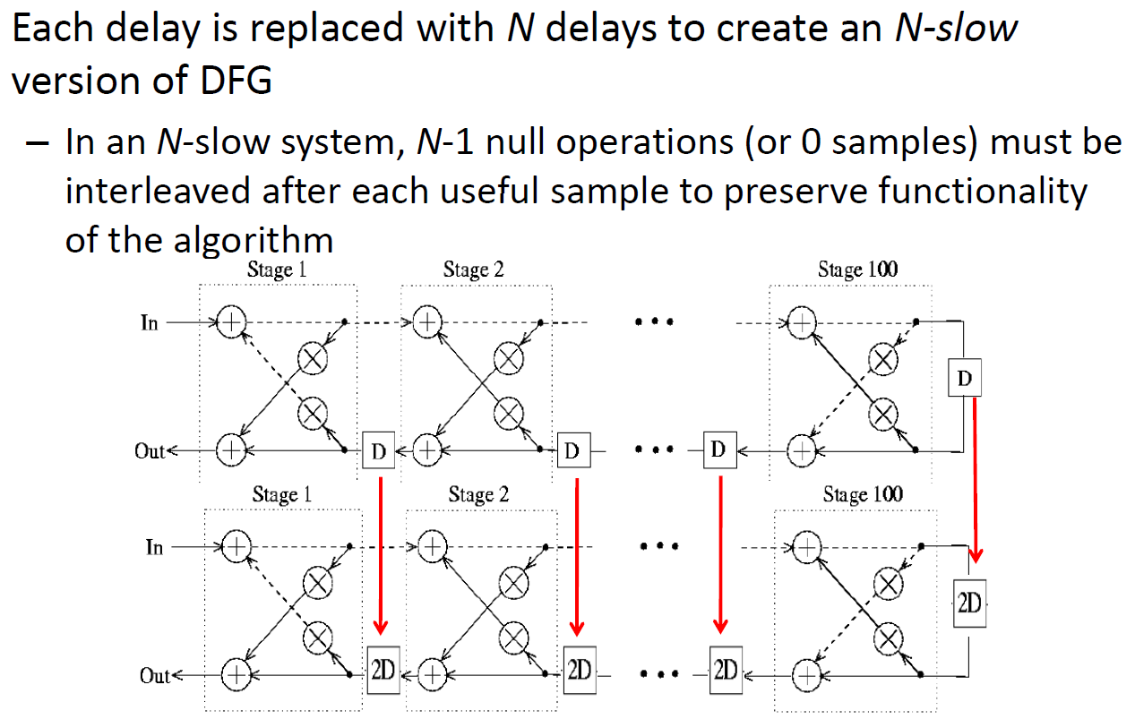
N‐Slow Down
Cutset retiming is often used in combination with slow-down.
The procedure is to first replace each delay in the DFG with N delays to create an N -slow version of the DFG and then to perform cutset retiming on the N –slow DFG

Slide 35
Time Scaling (Slow Down)
Transform each delay element (register) D to ND and reduce the sample frequency by N fold will slow down the computation N times.
During slow down, the processor clock cycle time remains unchanged. Only the sampling cycle time increased.
Provides opportunity for retiming, and interleaving.
… x(3) x(2) x(1)
… y(3) y(2) y(1)
+
D
×
… -- x(3) -- x(2) -- x(1)
… y(3) -- y(2) -- y(1)
+
2D
×

Slide 36
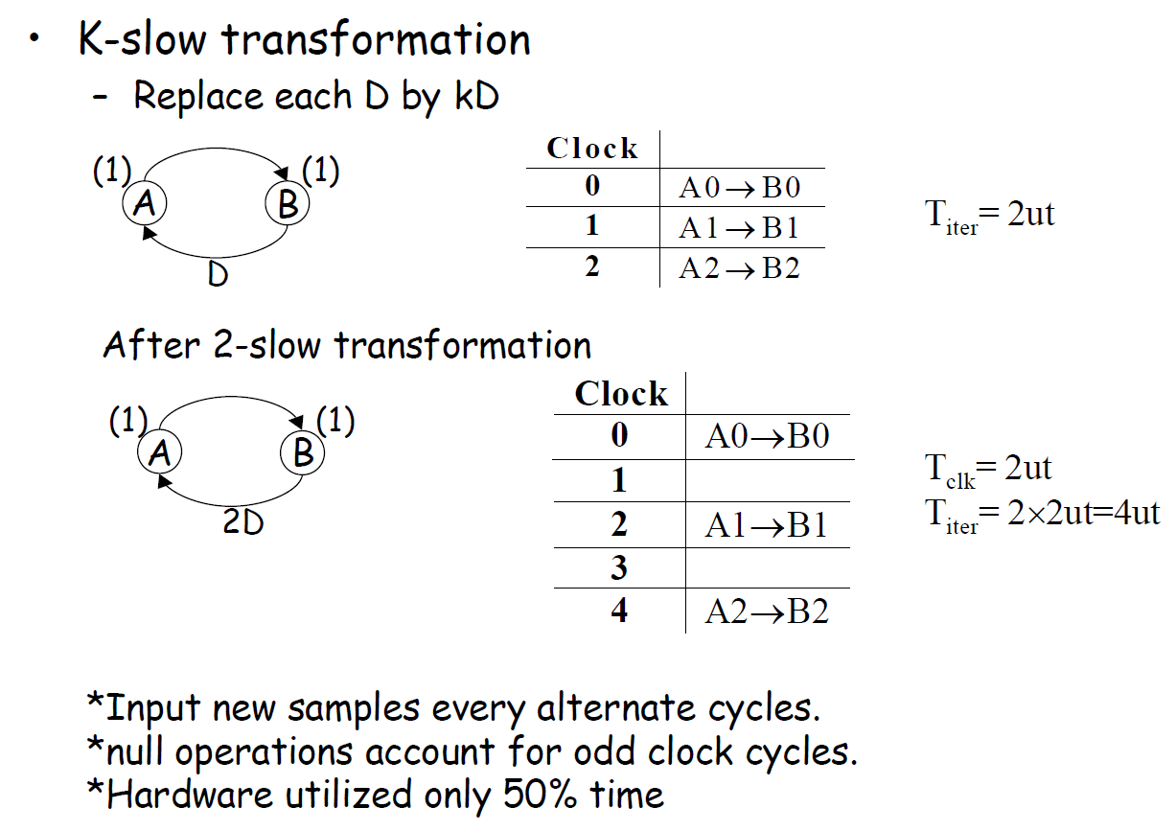

Slide 37
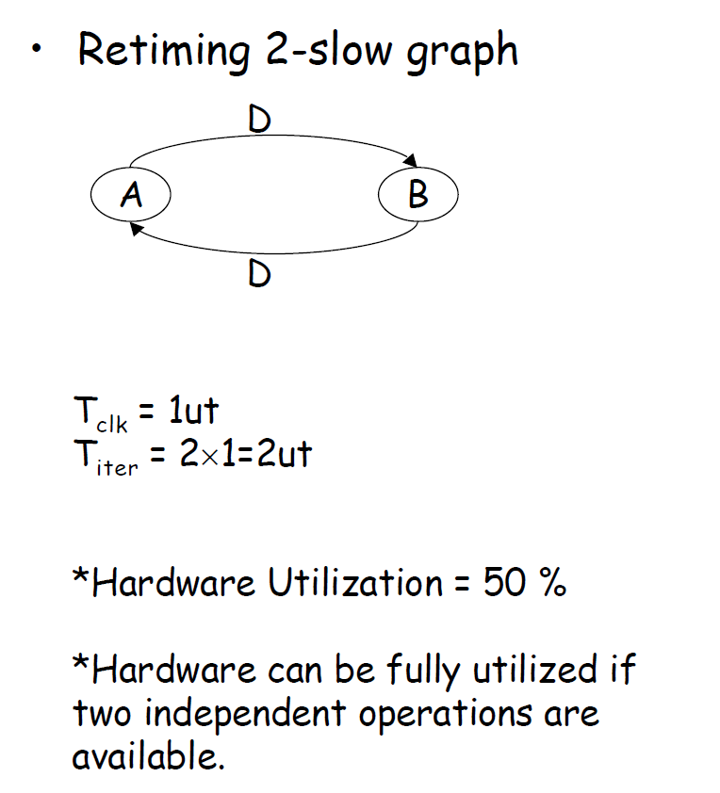

Slide 38
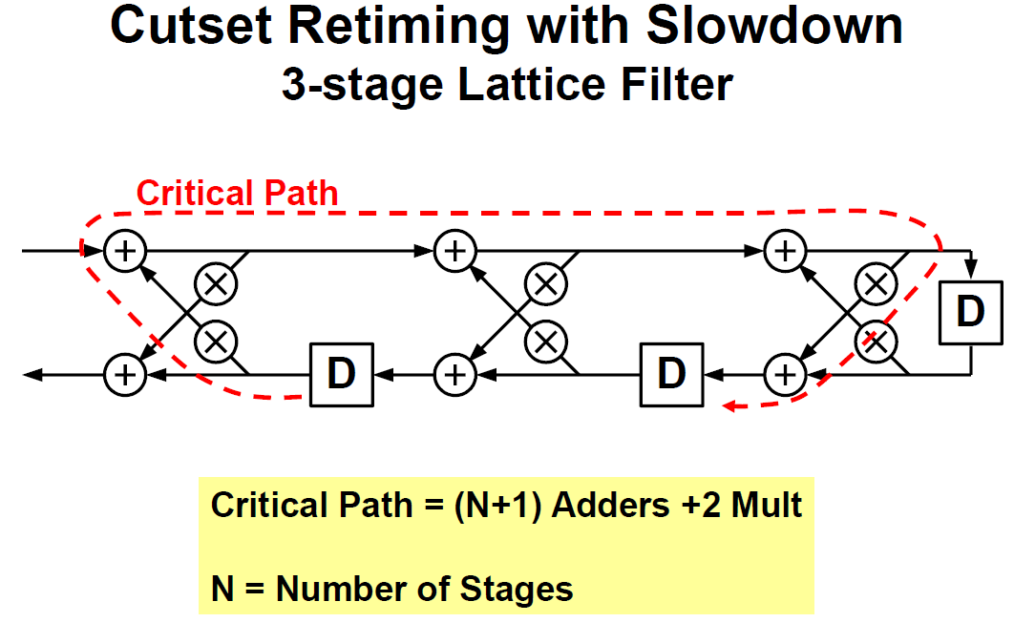

Slide 39
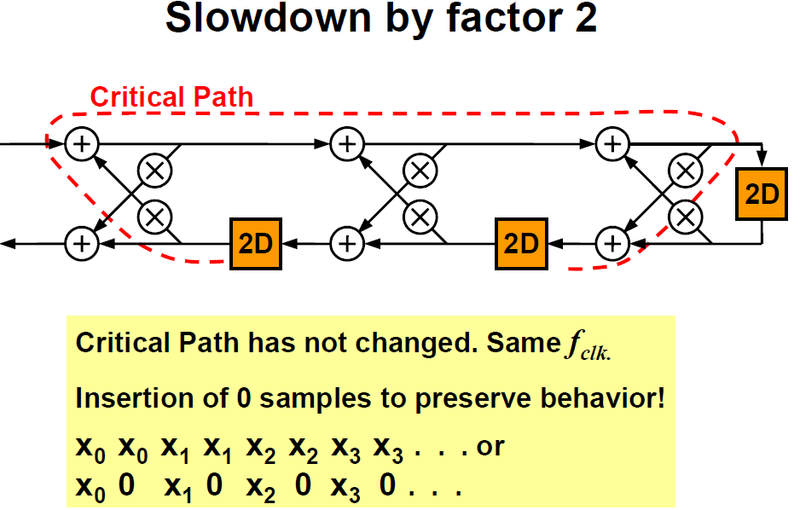

Slide 40
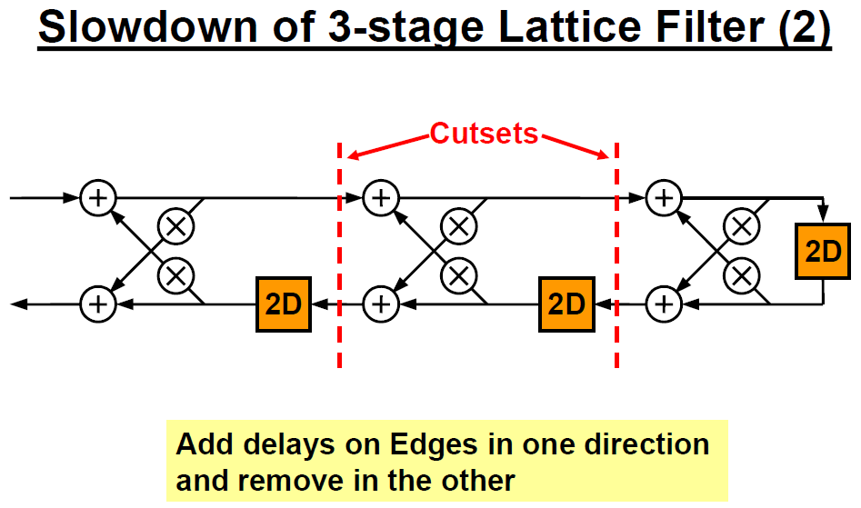

Slide 41
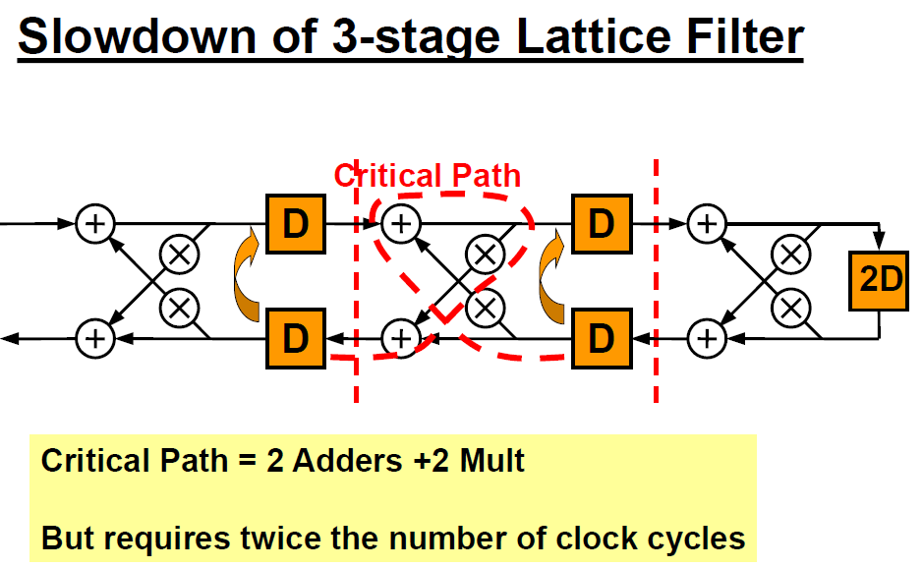

Slide 42
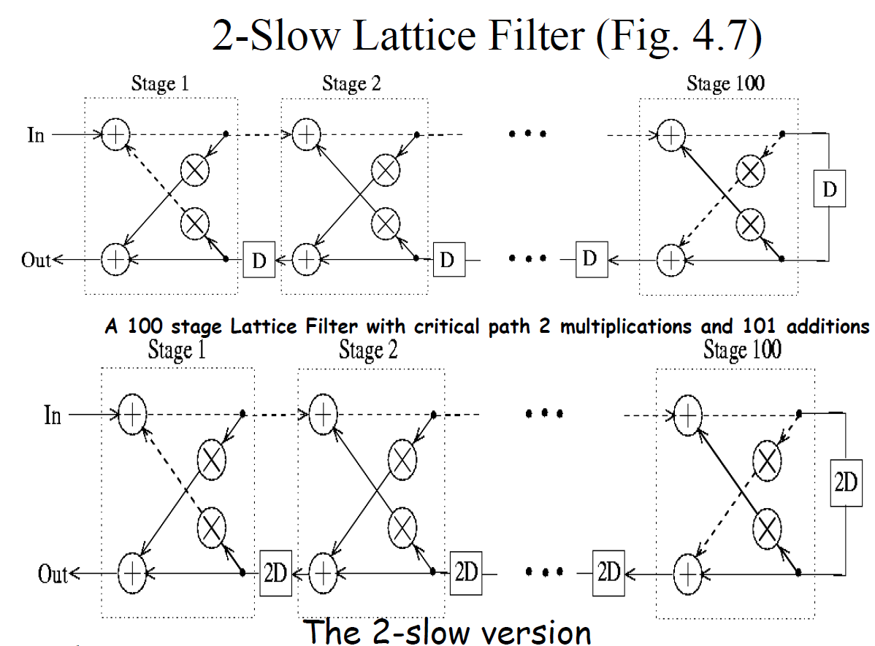

Slide 43
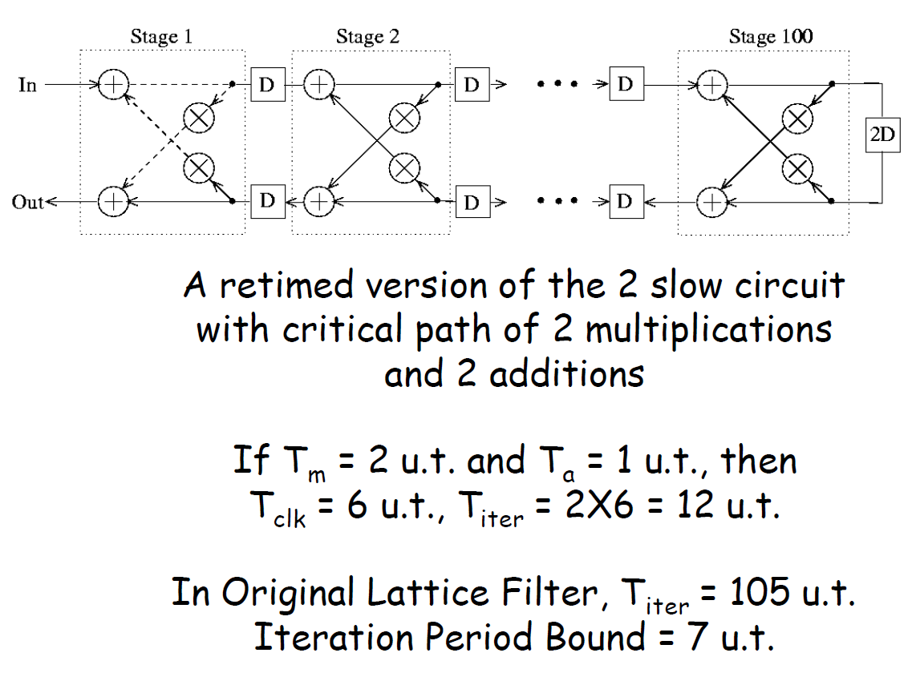
Retiming of N‐Slow Down with Cutset Retiming

Slide 44
4.4.2 Retiming for Clock Period Minimization
In previous lectures, we have learned to calculate the iteration bound of a DFG
Iteration bound determines the minimum clock period of a recursive DFG
Retiming for clock period minimization is the tool used to cause a recursive DFG to have a clock period to equal the iteration bound

Slide 45
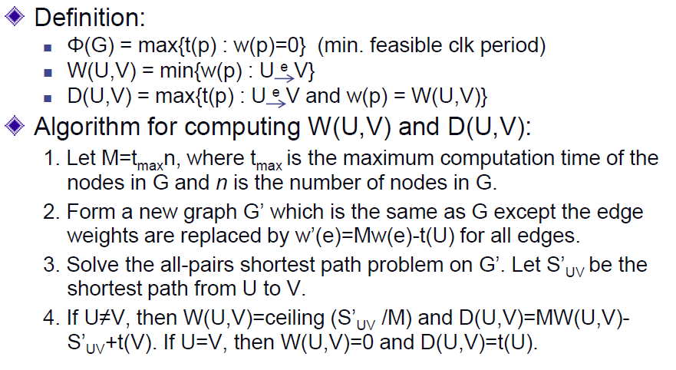
Retiming for Clock Period Minimization (1/2)
45

Slide 46
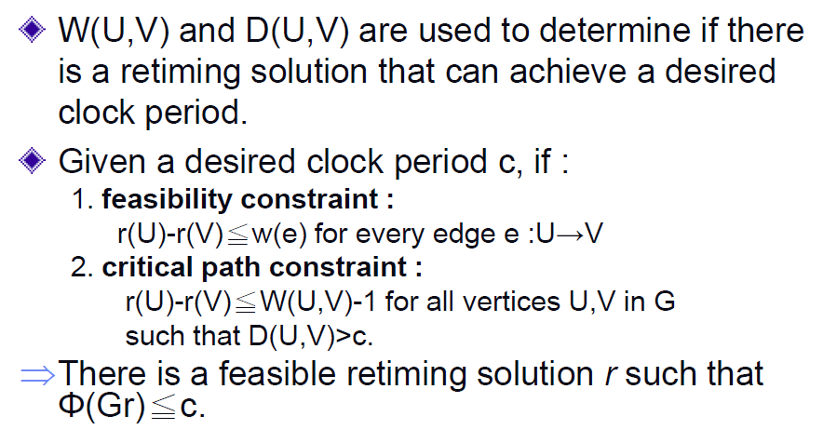
Retiming for Clock Period Minimization (2/2)
46

Slide 47
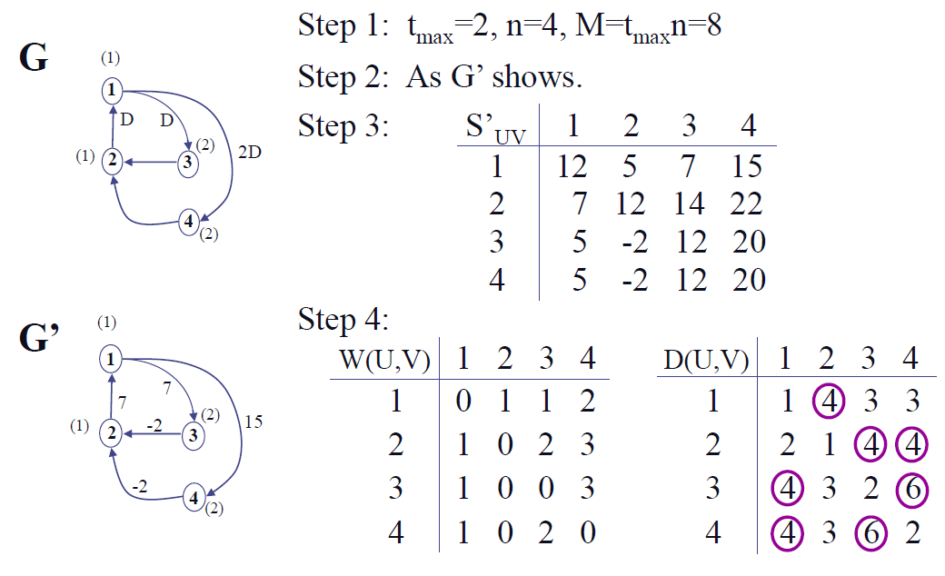
Example with c=3 (1/3)

Slide 48
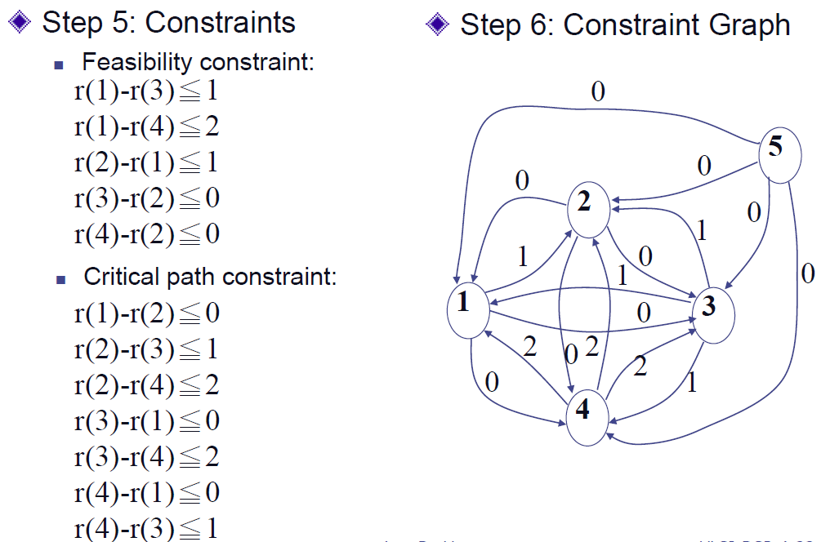
Example with c=3 (2/3)

Slide 49
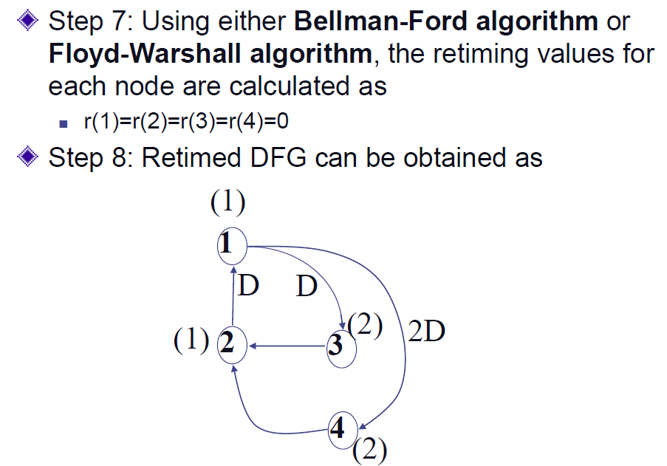
Example with c=3 (3/3)

Slide 50
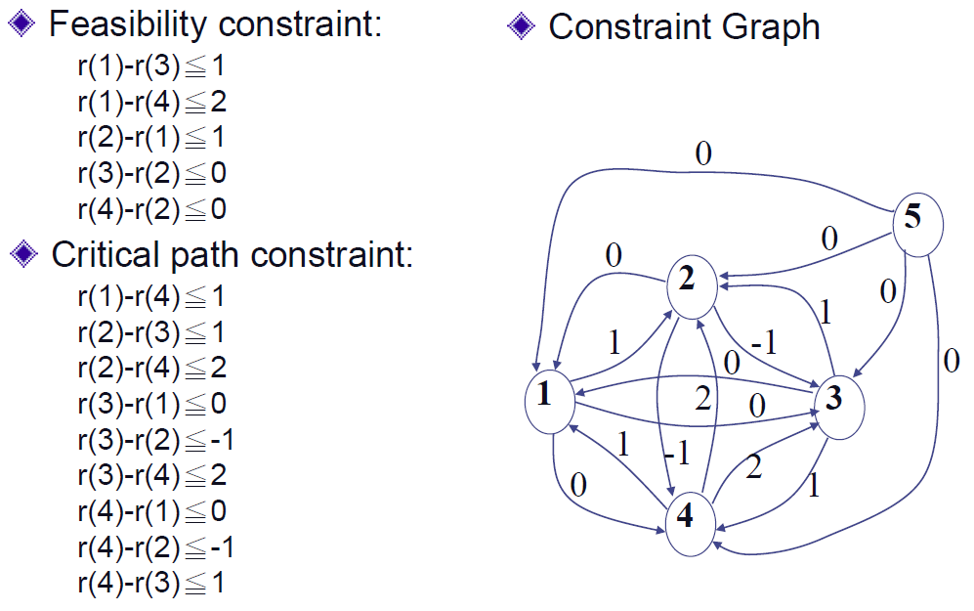
Example with c=2 (1/2)

Slide 51
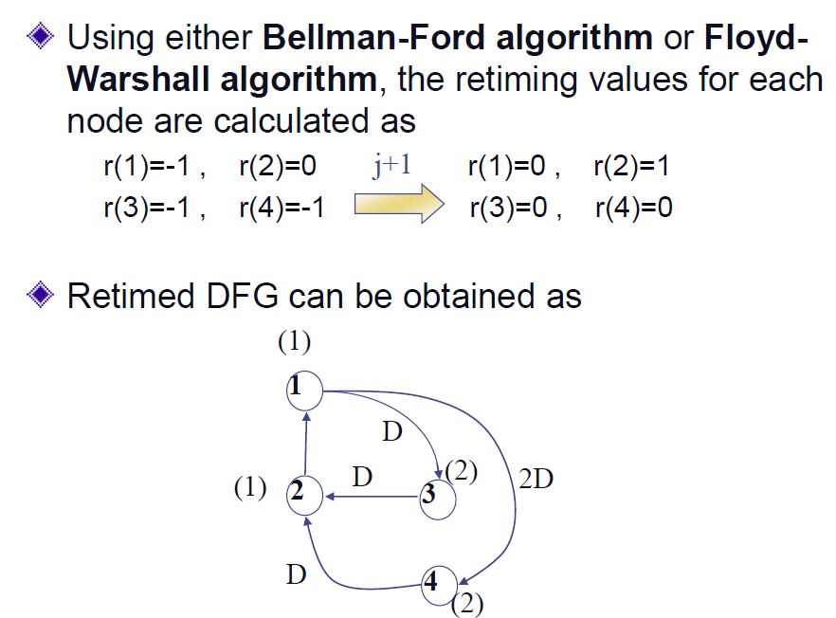
Example with c=2 (2/2)

Slide 52
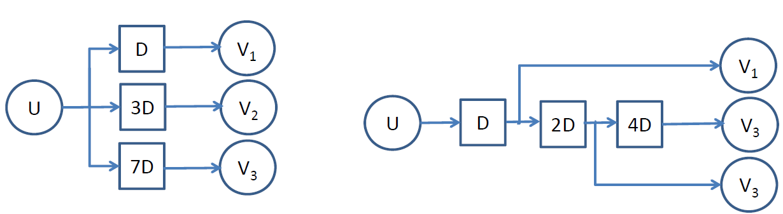
Retiming to Reduce Registers
4.4.3 Retiming for Register Minimization
D
D
Delay reduction
D
(a) Usage: 1 + 3 + 7 = 11 Reg
(b) Usage: 1 + 2 + 4 = 7 Reg
Register Sharing
When a node has multiple fan-out with different number of delays, the registers can be shared so that only the branch with max. # of delays will be needed.
Register reduction through node delay transfer from multiple input edges to output edges (e.g. r(v) > 0)
Should be done only when clock cycle constraint (if any) is not violated.

Slide 53
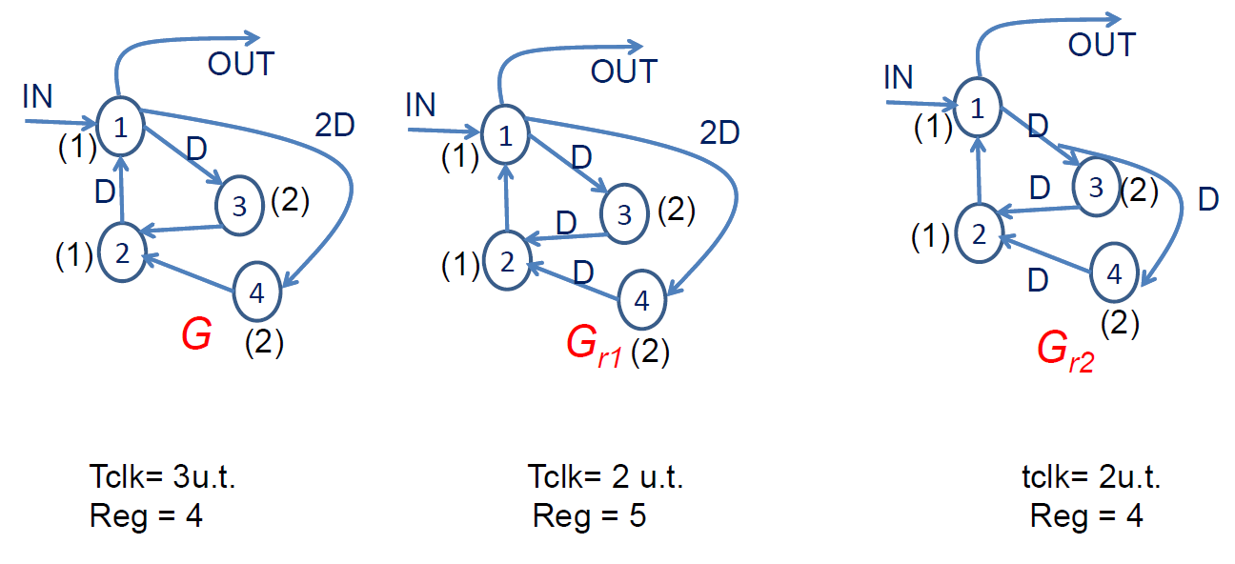
Retiming for General DFG
Example:

Slide 54
Other Applications of Retiming
Retiming for Folding (Chapter 6)
Retiming for Power Reduction (Chap. 17)
Retiming for Logic Synthesis (Beyond Scope of This Class)
Multi-Rate/Multi-Dimensional Retiming (Denk/Parhi, Trans. VLSI, Dec. 98, Jun.99)

Slide 55
4.5 Conclusion
Reduction of clock period, number of registers, and power consumption by retiming for synchronous systems
Shortest path algorithms can be used to obtain a retiming solution if one exists.
Retiming can also be used as a preprocessing step for folding and for computation of round-off noise as discussed in Chap 6 and 11, respectively.

Slide 56
Appdenix: Bellman-Ford Algorithm
Find shortest path from an arbitrarily chosen origin node U to each node in a directed graphif no negative cycle exists.
Given a direct graph
w(m,n): weight on edge from node m to node n, = ∞ if there is no edge from m to n
r(i,j): the shortest path from node U to node i within j-1 steps.
r(i,1) = w(U,i),
r(i,j+1) = min {r(k,j) + w(k,i)},
j = 1, 2, …, N-1
if max(r(:,n-1)-r(:,n))>0, then there is a negative cycle. Else, r(i,n-1) gives shortest cycle length from i to U.
−3
2
1
1
1
1
4
2
3
Note that 1 > 0, hence there is at least one negative cycle.

Slide 57
Retiming Example – Bellman-Ford Algorithm
For retiming example:
r(2) – r(1) ≤ 1
r(1) – r(3) ≤ 0
r(1) – r(4) ≤ 1
r(3) – r(2) ≤ –1
r(4) – r(2) ≤ –1
Bellman-Ford Algorithm for Shortest Path
−1
3
0
1
1
2
1
−1
0
0
4
0
0
5

Slide 58
Floyd-Warshall Algorithm
Find shortest path between all possible pairs of nodes in the graph provided no negative cycle exists.
Algorithm:
Initialization: R⁽¹⁾ =W;
For k=1 to N
R^{(k+1)}(u,v) = min{R^{(k)}(u,:) + R^{(k)}(:,v)}
If R^{(k)}(u,u) < 0 for any k, u, then a negative cycle exist. Else, R^{(N+1)}(u,v) is SP from u to v
−3
2
1
2
1
1
4
2
3

Slide 59
Retiming Example – Floyd-Warshall algorithm
Floyd-Warshall algorithm

